Slide 1
Presented by Maaz Habib & Mujtaba Abbas
Ransomware

Slide 2
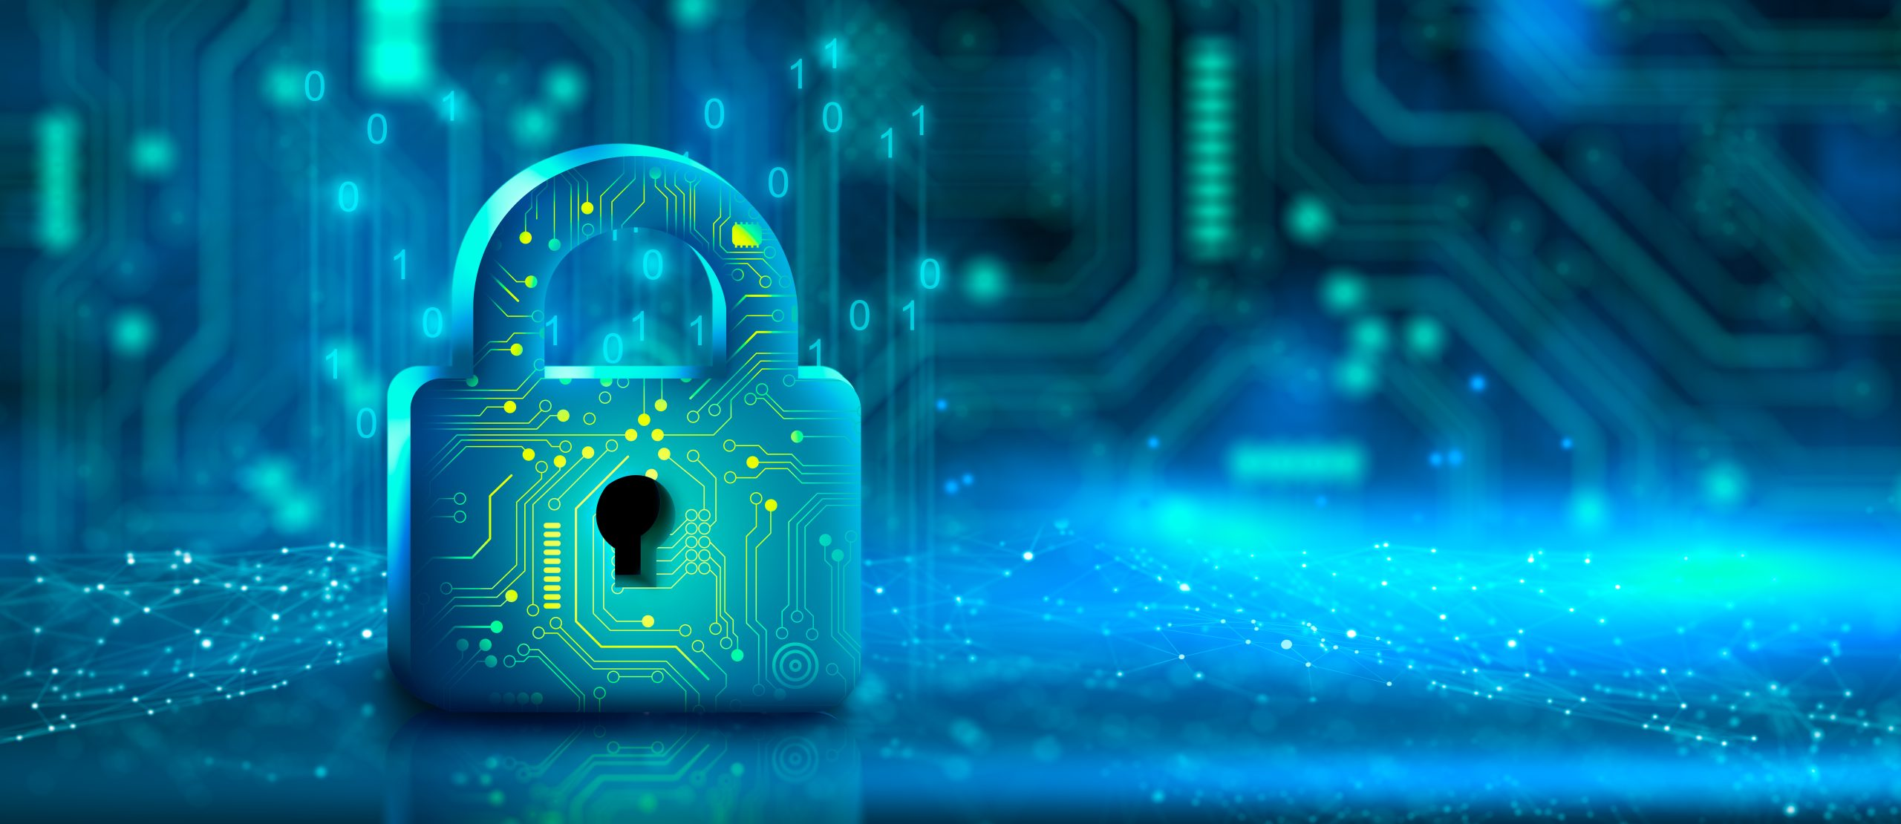
Table of content
Definition
What is ransomware?
Evolution
Evolution and it’s types
How it works
Working of ransomware attacks
How to avoid
Avoidance and removal of ransomware
Detection method
Solution

Slide 3
01
What is ransomware?

Slide 4
“Ransomware locks the victim's files or their system, demanding a ransom payment to restore access.”
Ransomware typically encrypts files on the infected system, making them inaccessible without the decryption key held by the attacker.
There is however no guarantee of actual recovery, even after payment is made.
According to the 2023 Data Protection Trends Report, 85% of organizations suffered at least one cyberattack in the preceding twelve months.

Slide 5
02
Evolution of Ransomware

Slide 6
1989 - The AIDS Trojan
First created by Joseph Popp a Harvard-trained evolutionary biologist.
The ransomware was distributed by infected floppy disks.
It disguised itself as a program that offered a survey related to AIDS research.
It encrypted file names on the victim's computer.
The attack affected a relatively small number of victims compared to modern ransomware attacks but set a precedent for future cyber threats.
2014 - Crypto Wall
Utilized advanced encryption techniques, making it difficult to decrypt files without paying the ransom.
Primarily spread through phishing emails containing malicious attachments or links.
Crypto Wall caused significant financial losses worldwide by encrypting files on infected systems and demanding ransom payments in Bitcoin.

Slide 7
2018 - Targeted Attacks
SamSam:
Attacked specific sectors such as healthcare and government institutions.
Used brute-force attacks to gain access to networks.
GandCrab:
Used Ransomware-as-a-Service (RaaS) model.
GandCrab spread widely due to its RaaS model, affecting numerous users and organizations globally.
Shutdown: The creators of GandCrab announced its shutdown in mid-2019, claiming to have earned billions from ransom payments.
2020s-Current trends:
The involvement of encrypting files but also stealing sensitive data before encryption. Attackers threaten to leak this data if ransom demands are not met, increasing pressure on victims to pay.

Slide 8
03
Types of Ransomware

Slide 9
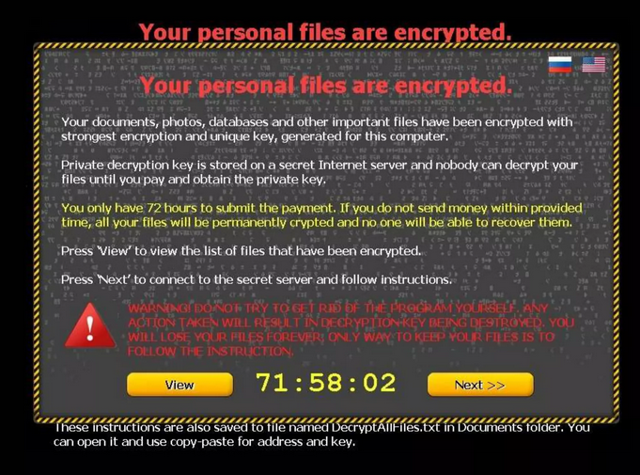
Types of Ransomware
Encrypting Ransomware:
Encrypts files on the victim's system using strong encryption algorithms, rendering them inaccessible without a decryption key.

Slide 10
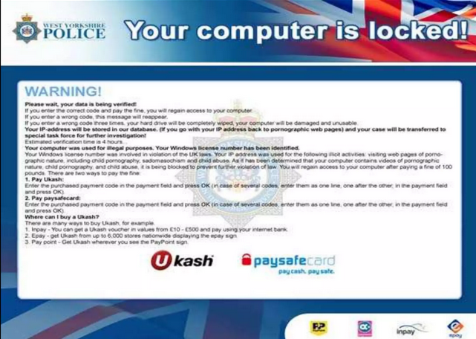
Types of Ransomware
Locker Ransomware:
Locks the victim out of their system entirely, preventing access to files or the entire operating system.

Slide 11
04
How Ransomware works

Slide 12
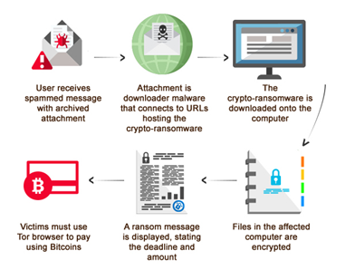

Slide 13
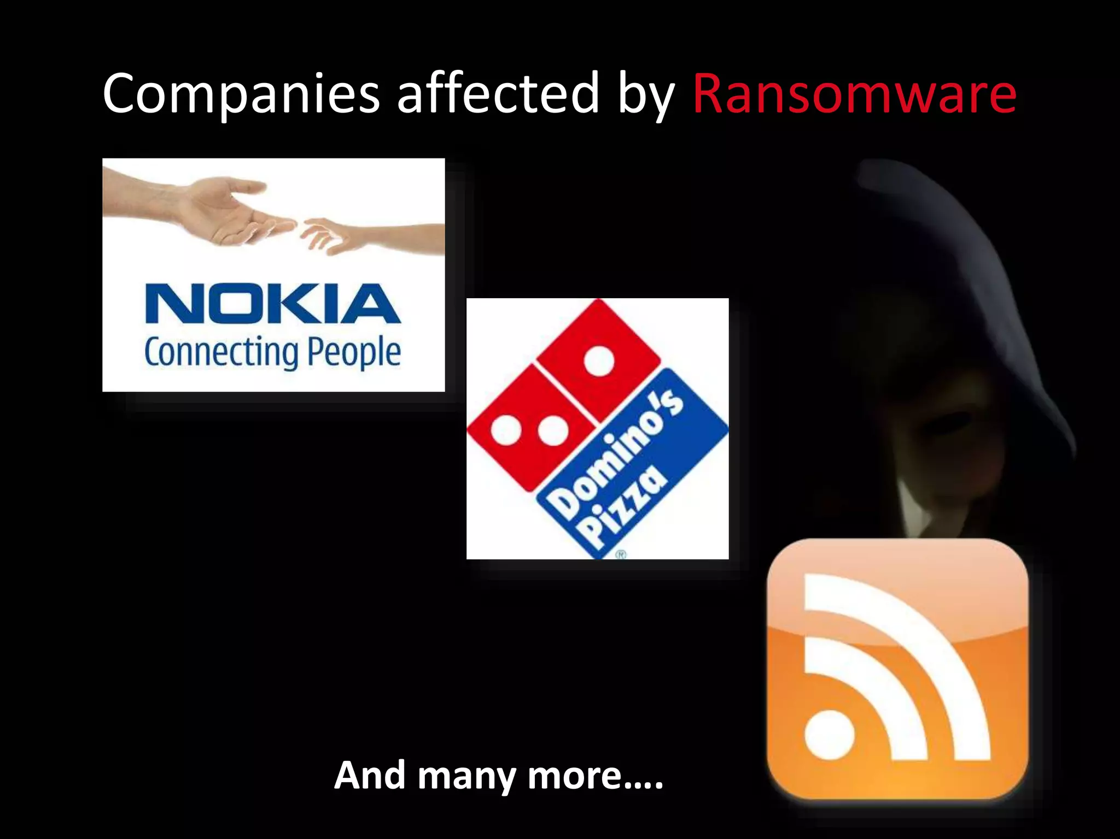

Slide 14
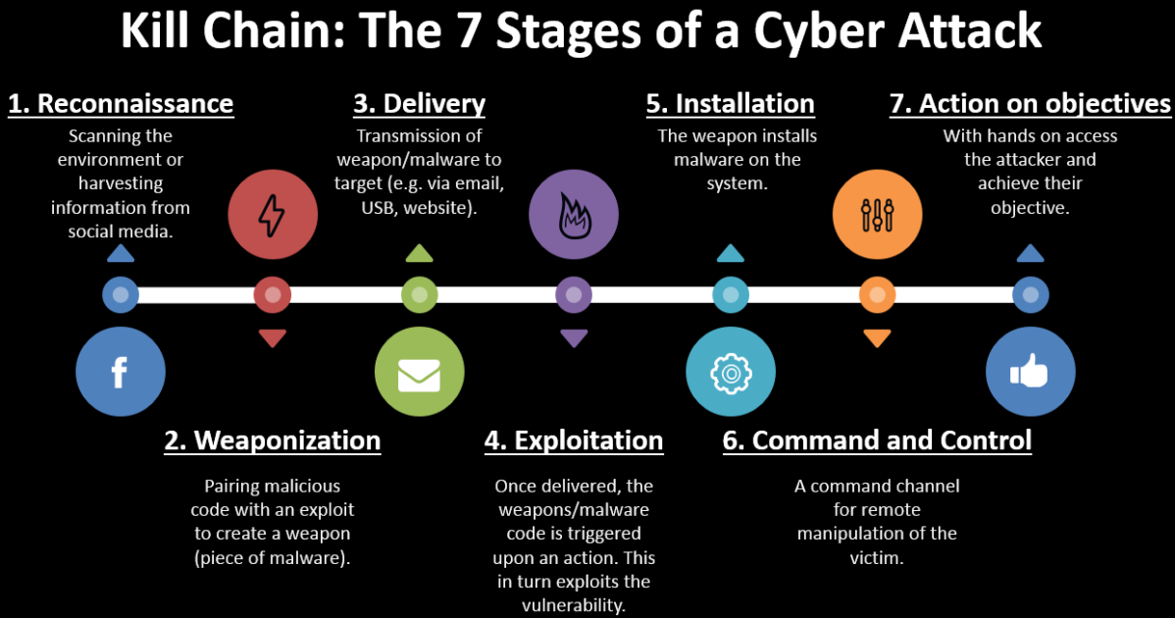
Ransomware Killchain

Slide 15
05
How to avoid

Slide 16
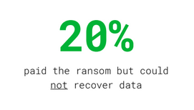
Regularly update your operating system, software, and antivirus programs to patch vulnerabilities that ransomware might exploit.
Keep backups of important files separate from your main system. This ensures you can restore your data without paying ransom if encrypted.
Learn about ransomware and share knowledge with family and colleagues to prevent accidental infections.
Have a response plan in place in case of a ransomware attack. This includes knowing how to disconnect from the internet and who to contact for support.
Even paying the ransom is not a guarantee that you’ll be able to recover.

Slide 17
06
Detection method

Slide 18
Network Based Detection:
DNS Request Monitoring
Malicious DNS queries can be detected
Network Storage Access
Analyzing traffic on Network
Specific Detection Methods:
Locky Ransomware Detection(IDS – RF/SVM/Bayes Network)(97%)
Samba Protocol Detection
REDFISH Scheme-(100% for 19 RW)
SDN Based Detection
R-Killer Scheme
Rapid Detection & Identification(LSTM)(97.2%)
Network Forensics for Cerber Ransomware
Social Network Ransonware Detection RF SVM (99%)
WannaCry Detection
DeepRam Detection (Bi-LSTM)(98.7%)
SND based Approach(97%-98%)
NetConverse (99.9%)
Host Based Detection:
Anti Viruses
Analyzing file ,memory, API Calls and DLL calls

Slide 19
07
Solution

Slide 20
Developing a Software using ML and AI to detect anomaly
LSTM or SVM models have most accuracy (95%-100%)
Combination of Both Network and Host based Detection System to catch threat in real-time

Slide 21
Thank you

